Slide 1



How to test software without writing tests.
Manuel Rigger
ETH Zurich, Switzerland
@RiggerManuel
https://www.manuelrigger.at/

Slide 2

SQLancer
https://github.com/sqlancer
SQLancer implements new techniques for testing DBMSs
@sqlancer_dbms

Slide 3

SQLancer
General insights on how you can apply automated testing techniques on your project
https://github.com/sqlancer
SQLancer implements new techniques for testing DBMSs

Slide 4
Database Management Systems (DBMS)
Structured Query Language (SQL)
Interact with
Database Management System

Slide 5
Database Management Systems (DBMS)
CREATE TABLE t0(c0 INT);
INSERT INTO t0 VALUES (-1) ;
SELECT * FROM t0 WHERE <p>;
Interact with
Database Management System

Slide 6

How can we write test cases
for Database Management Systems?

Slide 7
How to manually test DBMSs?
zlob_print.test
zlob_print.result
--source include/have_debug.inc
--source include/have_innodb_max_16k.inc
set global innodb_compression_level = 0;
create table t1 (f1 int primary key, f2 longblob)
row_format=compressed, engine=innodb;
set debug='+d,innodb_zlob_print';
insert into t1 values (1, repeat('+', 1048576));
set debug='-d,innodb_zlob_print';
select f1, right(f2, 40) from t1;
drop table t1;
set global innodb_compression_level = default;
set global innodb_compression_level = 0;
create table t1 (f1 int primary key, f2 longblob)
row_format=compressed, engine=innodb;
set debug='+d,innodb_zlob_print';
insert into t1 values (1, repeat('+', 1048576));
set debug='-d,innodb_zlob_print';
select f1, right(f2, 40) from t1;
f1 right(f2, 40)
1 ++++++++++++++++++++++++++++++++++++++++
drop table t1;
set global innodb_compression_level = default;
It is challenging and time-consuming to write manual tests for large software systems
https://github.com/mysql/mysql-server/blob/8.0/mysql-test/suite/innodb/t/zlob_print.test
https://github.com/mysql/mysql-server/blob/8.0/mysql-test/suite/innodb/r/zlob_print.result

Slide 8
Can we automate the
testing process?

Slide 9
Automatic Testing Core Challenges
Generate a Database
Generate a Query
Validate the Query’s Result
Effective test case

Slide 10
SQLsmith
SELECT …;
Potentially highly complex
Database Management System
SEGMENTATION FAULT
Database db
SQLsmith is an effective and widely-used random query generation tool
https://github.com/anse1/sqlsmith

Slide 11

Automatic Testing Core Challenges
Use a random-generation approach
to automatically generate tests
Generate a Database
Generate a Query
Validate the Query’s Result

Slide 12
Automatic Testing Core Challenges
“Test oracle” problem
Generate a Database
Generate a Query
Validate the Query’s Result

Slide 13
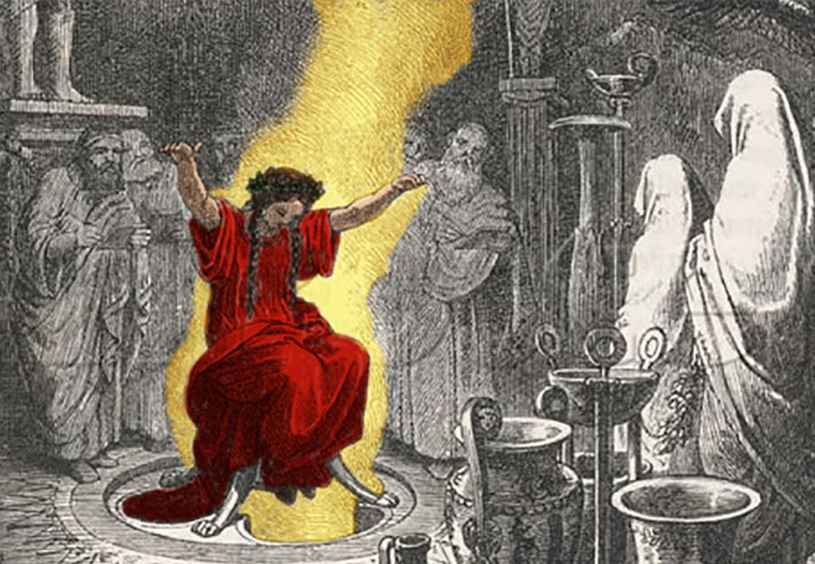
Test Oracle
Incorrect result!
Difficult, even for manually-written test cases!
“a test oracle (or just oracle) is a mechanism for determining whether a test has passed or failed”
https://en.wikipedia.org/wiki/Test_oracle

Slide 14

Motivating Example
t0
t1
c0
0.0
c0
-0.0
SELECT * FROM t0, t1
WHERE t0.c0 = t1.c0;
?
It might seem disputable whether the predicate should evaluate to true

Slide 15
Motivating Example
0
0
0
0
0
…
0
0
0
0
t0
t1
false?
-0
1
0
0
0
…
0
0
0
0
c0
0.0
c0
-0.0
Different binary representation
SELECT * FROM t0, t1
WHERE t0.c0 = t1.c0;
t0.c0 | t1.c0

Slide 16
Motivating Example
t0
t1
Evaluates to true for most programming languages
true?
c0
0.0
c0
-0.0
t0.c0 | t1.c0
0 | -0
SELECT * FROM t0, t1
WHERE t0.c0 = t1.c0;

Slide 17
Motivating Example
t0
t1
c0
0.0
c0
-0.0
t0.c0 | t1.c0
0 | -0
SELECT * FROM t0, t1
WHERE t0.c0 = t1.c0;
✓

Slide 18

Motivating Example
t0
t1
The latest version of MySQL that we tested failed to fetch the row
c0
0.0
c0
-0.0
SELECT * FROM t0, t1
WHERE t0.c0 = t1.c0;
t0.c0 | t1.c0
✗
https://bugs.mysql.com/bug.php?id=99122

Slide 19
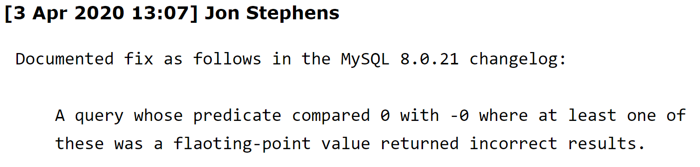
Motivating Example
t0
t1
c0
0.0
c0
-0.0
SELECT * FROM t0, t1
WHERE t0.c0 = t1.c0;
t0.c0 | t1.c0
✗
https://bugs.mysql.com/bug.php?id=99122

Slide 20
Motivating Example
t0
t1
We could find the bug without having an accurate understanding ourselves
c0
0.0
c0
-0.0
SELECT * FROM t0, t1
WHERE t0.c0 = t1.c0;
t0.c0 | t1.c0
✗
https://bugs.mysql.com/bug.php?id=99122

Slide 21
Motivating Example
t0
t1
c0
0.0
c0
-0.0
Incorrect result!
SELECT * FROM t0, t1
WHERE t0.c0 = t1.c0;
t0.c0 | t1.c0
https://bugs.mysql.com/bug.php?id=99122

Slide 22
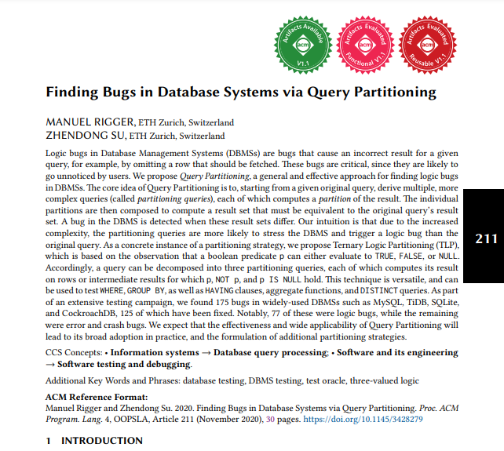
Ternary Logic Partitioning (TLP)
https://dl.acm.org/doi/abs/10.1145/3428279

Slide 23

My Research
Incorrect result!
Idea: test the DBMS against itself

Slide 24
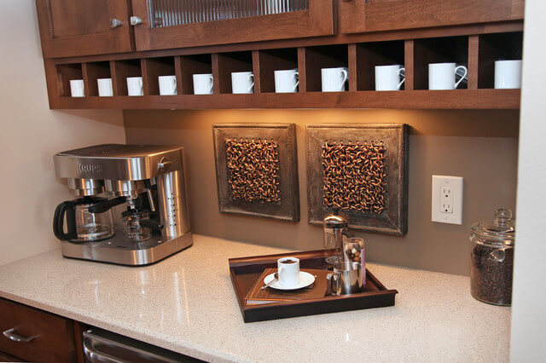
Scenario: Coffee Kitchen

Slide 25




Tangerines vs. Clementines

Slide 26
Tangerines vs. Clementines
tangerines

Slide 27
Tangerines vs. Clementines
clementine

Slide 28
Tangerines vs. Clementines

Slide 29
Tangerines vs. Clementines
I can never tell different citrus fruits apart

Slide 30
Tangerines vs. Clementines
Show me

Slide 31
Tangerines vs. Clementines
Please bring me all clementines
2 fruits

Slide 32
Tangerines vs. Clementines
Please bring me all clementines

Slide 33
Tangerines vs. Clementines
Please bring me all fruits that are not clementines
4 fruits

Slide 34
Tangerines vs. Clementines
2 fruits
4 fruits
6 fruits

Slide 35
Tangerines vs. Clementines
You likely classified a fruit as both a tangerine and a clementine!
5 fruits
2 fruits
4 fruits
6 fruits

Slide 36
Insight
Insight: Every object in a (mathematical) universe is either a clementine or not a clementine

Slide 37
Tangerines vs. Clementines
Clementines!
We cannot find all bugs
tangerines

Slide 38
Ternary Logic
Consider a predicate p and a given row r. Exactly one of the following must hold:
p
NOT p
p IS NULL

Slide 39
Ternary Logic
Consider a predicate p and a given row r. Exactly one of the following must hold:
p
NOT p
p IS NULL
p
NOT p
p IS NULL

Slide 40
Motivating Example
t0
t1
How did this insight allow us to detect this bug?
c0
0.0
c0
-0.0
SELECT * FROM t0, t1
WHERE t0.c0 = t1.c0;
t0.c0 | t1.c0
✗
https://bugs.mysql.com/bug.php?id=99122

Slide 41
Example: MySQL
p
SELECT * FROM t0, t1;
SELECT * FROM t0, t1 WHERE t0.c0=t1.c0
UNION ALL
SELECT * FROM t0, t1 WHERE NOT (t0.c0=t1.c0)
UNION ALL
SELECT * FROM t0, t1 WHERE (t0.c0=t1.c0) IS NULL;
t0.c0 | t1.c0
0.0 | -0.0
t0.c0 | t1.c0
✗
≠
https://bugs.mysql.com/bug.php?id=99122

Slide 42
Scope
WHERE
GROUP BY
HAVING
DISTINCT queries
Aggregate functions

Slide 43
Automatic Testing Core Challenges
Use a random-generation approach
to automatically generate tests
Generate a Database
Generate a Query
Validate the Query’s Result

Slide 44
Automatic Testing Core Challenges
Generate a Database
Generate a Query
Validate the Query’s Result
Ternary Logic Partitioning

Slide 45
Can such a simple technique be effective?

Slide 46





More than 450 Bugs
PostgreSQL
I used SQLancer to find over 450 unique, previously unknown bugs in widely-used DBMSs

Slide 47
What should I take away from this talk?

Slide 48
Generalizing the Findings
Insight: While the specific technique works primarily for data-oriented systems, it is based on a more general technique

Slide 49
Generalizing the Technique
t0.c0 | t1.c0
0.0 | -0.0
SELECT * FROM t0, t1;
Derive
SELECT * FROM t0, t1 WHERE t0.c0=t1.c0
UNION ALL
SELECT * FROM t0, t1 WHERE NOT (t0.c0=t1.c0)
UNION ALL
SELECT * FROM t0, t1 WHERE (t0.c0=t1.c0) IS NULL;

Slide 50
Generalizing the Technique
Test Case
Execute
Result
Derive
SELECT * FROM t0, t1 WHERE t0.c0=t1.c0
UNION ALL
SELECT * FROM t0, t1 WHERE NOT (t0.c0=t1.c0)
UNION ALL
SELECT * FROM t0, t1 WHERE (t0.c0=t1.c0) IS NULL;

Slide 51
Generalizing the Technique
Test Case
Execute
Result
Derive
Derived
Test Case

Slide 52
Generalizing the Technique
Test Case
Execute
Result
Derive
Derived
Test Case
The general concept is known as metamorphic testing

Slide 53
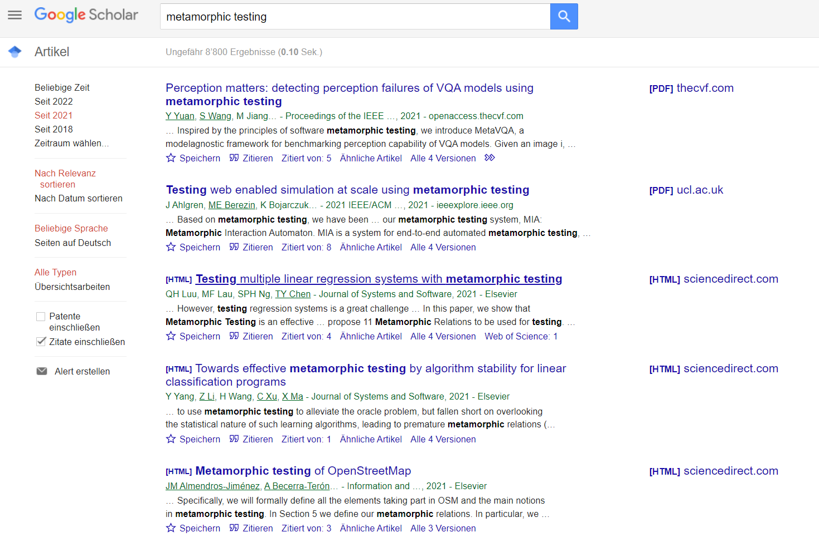
Metamorphic Testing
Creating an effective technique is challenging, check Google Scholar if you can find existing ones!

Slide 54
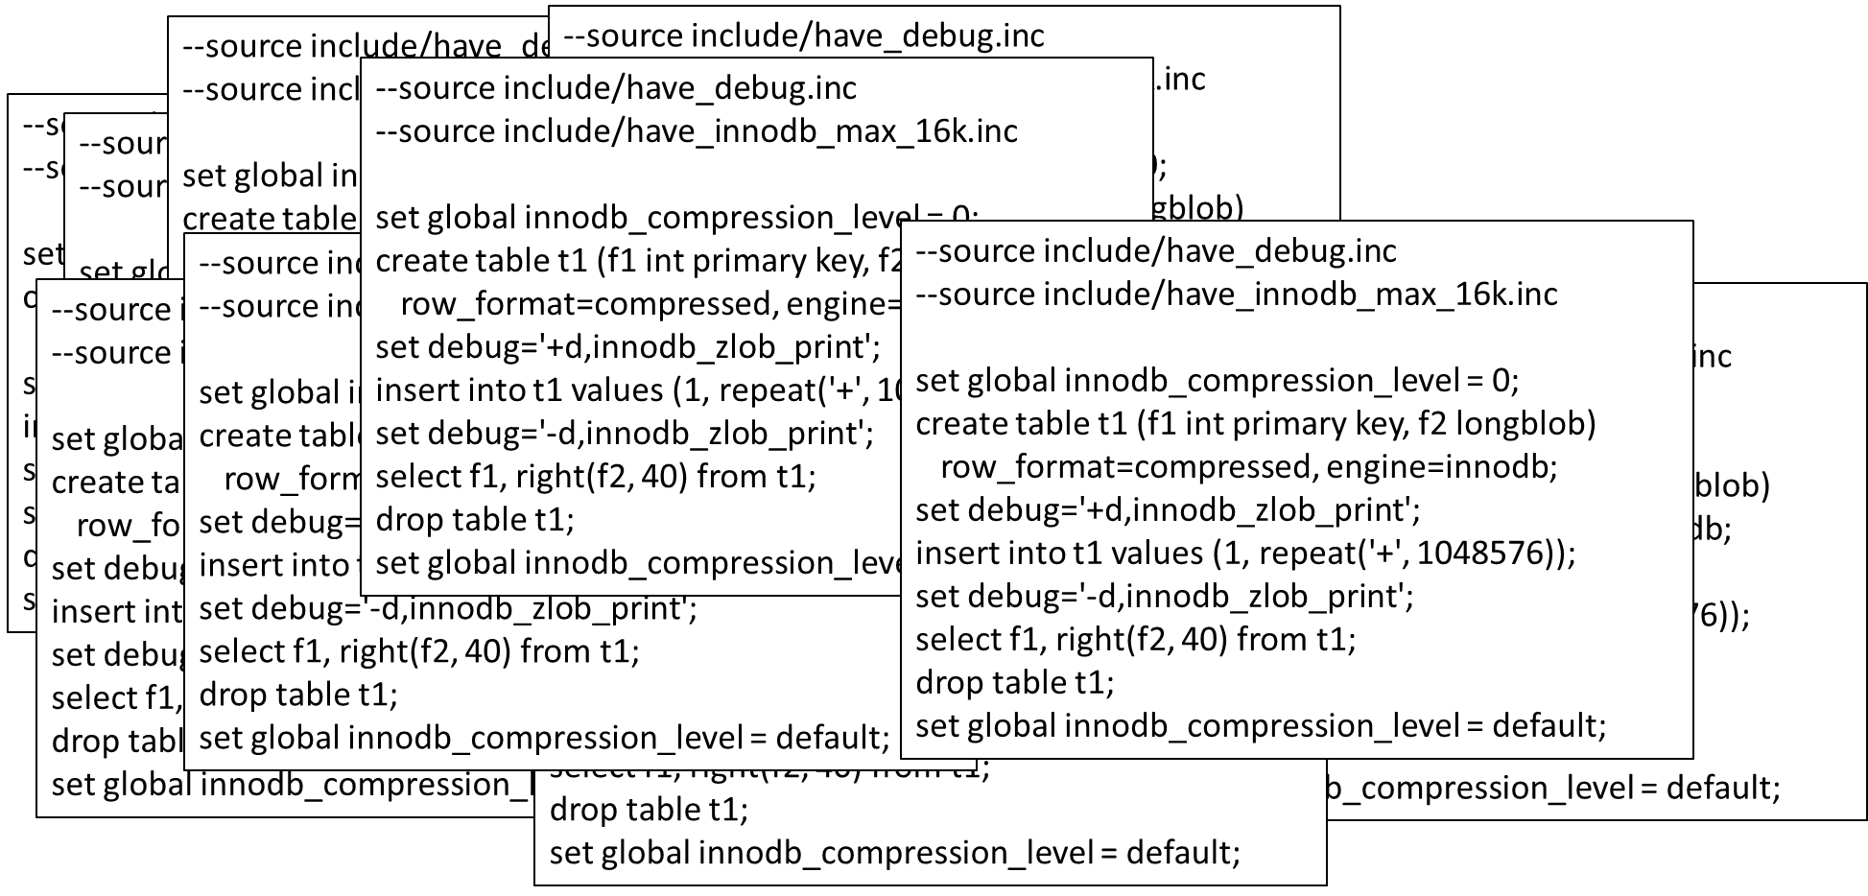
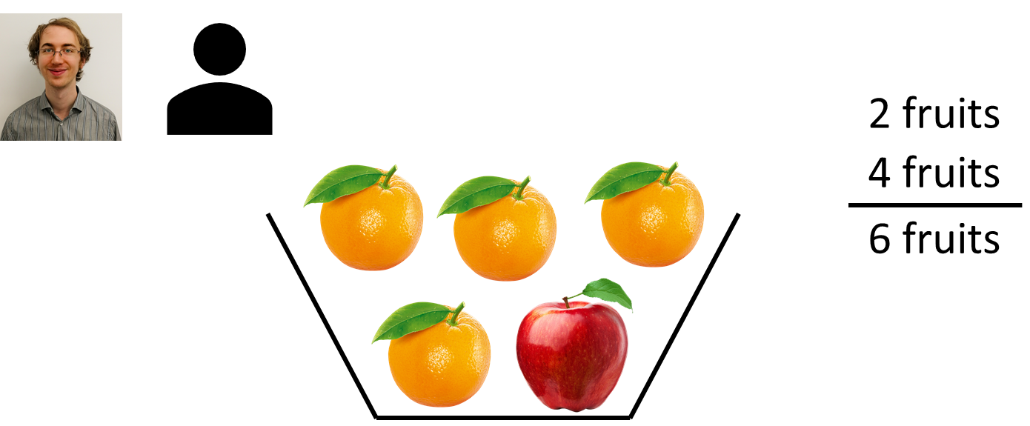


Summary & Takeaway
Manually writing test cases is time intensive and requires detailed domain knowledge
Coupling random test case generation with a metamorphic test oracle is effective in finding bugs
@RiggerManuel @sqlancer_dbms

